Slide 1

Lecture 12 Deliver the Customer Experience

Slide 2
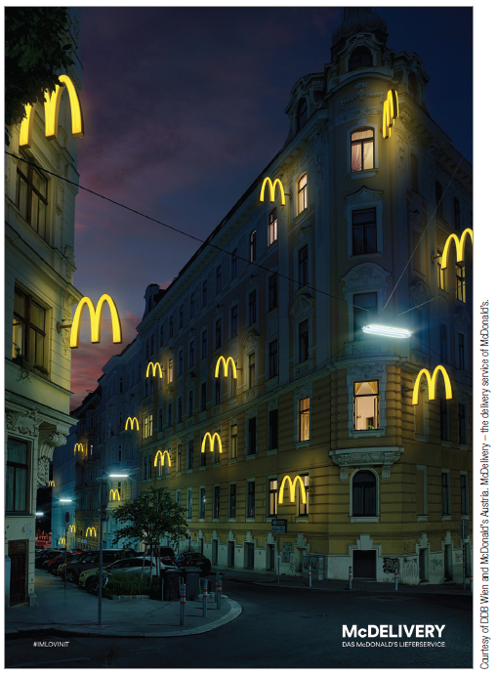
Retailing, Twenty-First-Century Style
Retailing is the process by which organizations sell goods and services to consumers for their personal use.
Provide time, place, and ownership utility
Retailing is big business:
2015 U.S. sales totaled $4.87 trillion
More than 1 in 10 U.S. workers employed in retail
Retailing practices vary around the world.
Notes:
Globally, retailing may have a very different face.
In some European countries, don’t even think about squeezing a tomato to see if it’s too soft or picking up a cantaloupe to see if it smells ripe. Such mistakes will quickly gain you a reprimand from the store clerk, who will choose your oranges and bananas for you.
In developing countries like those in Asia, Africa, and South America, retailing often includes many small butcher shops where sides of beef and lamb proudly hang in store windows so everyone will be assured that the meat comes from healthy animals.

Slide 3
The Evolution of Retailing
Retailing has taken many forms over time –
From the peddler hawking wares from a horse-drawn cart to a majestic urban department store
As the economic, social, and cultural climates change, different retail types emerge …
Often squeezing out older, outdated models
Wheel-of-retailing hypothesis

Slide 4
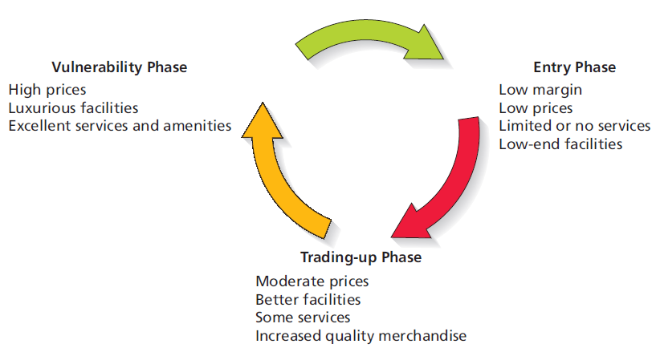
The Wheel of Retailing
Notes:
The Wheel of Retailing Theory explains how retail firms change, becoming more upscale as they go through their life cycle.
During the entry phrase, new types of retailers enter the market by offering lower-priced goods with little focus on additional services or the facility itself.
During the trading-up phrase, these retailers gradually improve their facilities, quality and assortment of merchandise, and amenities and also increase prices.
Finally, retailers move up to a high-end strategy with superior facilities, desirable amenities (free gift wrapping), higher operating costs, and of course higher prices. However, this leaves them vulnerable to the entry of new competitors, who undercut their price, offer limited services, and etc., as the entry phrase begins anew.
New ways to sell products are constantly appearing. American Airlines tested the concept of selling services such as Heathrow Express train tickets on London-bound flights, and items from the SkyMall catalog on 165 of its planes.
Still, trading up or upgrading too quickly can spell disaster for a retailer. Walmart attempt to upgrade its clothing line from the basic T-shirt, shorts, and pants collections to brand-name apparel that proved to be out-of-reach of the loyal core user.
While the wheel of retailing helps explain how some retailing forms develop, it doesn’t explain everything. For example, some retailers never trade-up but instead choose to continue to serve their niche as discounters. Still other retailers strategically choose to begin their life as upscale specialty stores, though they sometimes choose to open “sister” stores at the lower end of the price spectrum (as was the case when Gap Stores chose to open Old Navy).

Slide 5
The Evolution Continues: What’s “In-Store” for the Future?
Four factors motivate innovative merchants to reinvent the way they do business:
Changes in economic conditions
Demographic and consumer preference change
Technology
Globalization

Slide 6
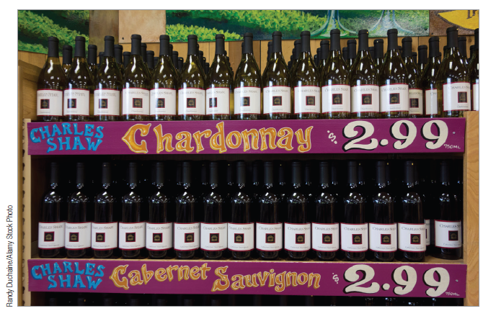
The Changing Economy
Economic downturn that began in 2008 had great impact on retailers
Lowered consumer confidence resulted in less discretionary spending.
Sales for upscale stores especially vulnerable
Stores like T.J. Maxx, Marshall’s, and Amazon.com thrived.
Some retailers responded by allocating more shelf space to private label brands.

Slide 7
Changing Demographics and Consumer Preferences
More dual-career families places greater emphasis on convenience
Increased number of locations and format
Extended hours
Ethnic diversity
Need to adjust retail mix to attract consumers in areas with high concentration of ethnic population
Experiential Merchandising
Tactic whose intent is to convert shopping from a passive activity into a more interactive one, by better engaging the customer
Destination Retailer
Firm that consumers view as distinctive enough to become loyal to it.

Slide 8
Technology
Technology is revolutionizing retailing!
Store associates carry an iPod Touch to quickly ring up sales from anywhere in the store
Electronic POS systems feed data into inventory control and auto replenishment systems
RFID tags on items
E-menus and other electronic ordering systems
Electronic banking
Notes:
Stores may use POS systems to create perpetual inventory unit control systems that keep a running total on sales, returns, transfers to other stores, and so on.
This technology allows stores to develop computerized automatic reordering systems that are activated when inventories reach a certain level.
The store of the future will use RFID tags (and other technology) to assist the shopper in ways we haven’t even thought of. For example, an RFID tag on a bottle of wine can tip off a nearby plasma screen that will project an ad for Barilla pasta and provide a neat recipe for fettuccine with bell peppers and shrimp.
e-menus help customers because they can see what every item on the menu will look like and, it is hoped, avoid a surprise when the waiter arrives. This innovation also increases sales for the restaurant—who can avoid that mouth-watering picture of the eight-layer chocolate cake with peppermint-stick ice cream on top?

Slide 9
Technology (contd)
Omni-channel Marketing
Seamless shopping experience whether shopping online, mobile device, phone, or brick-and-mortar
Beacon Marketing
Bluetooth signal within a store that communicates with shoppers’ smartphones
Digital Wallets
Bluetooth technology permitting customers to use their smartphones to pay for items

Slide 10
Globalization
Many retailers have expanded operations into different countries.
Retailers must adjust to global differences in culture, law, and regulations.

Slide 11
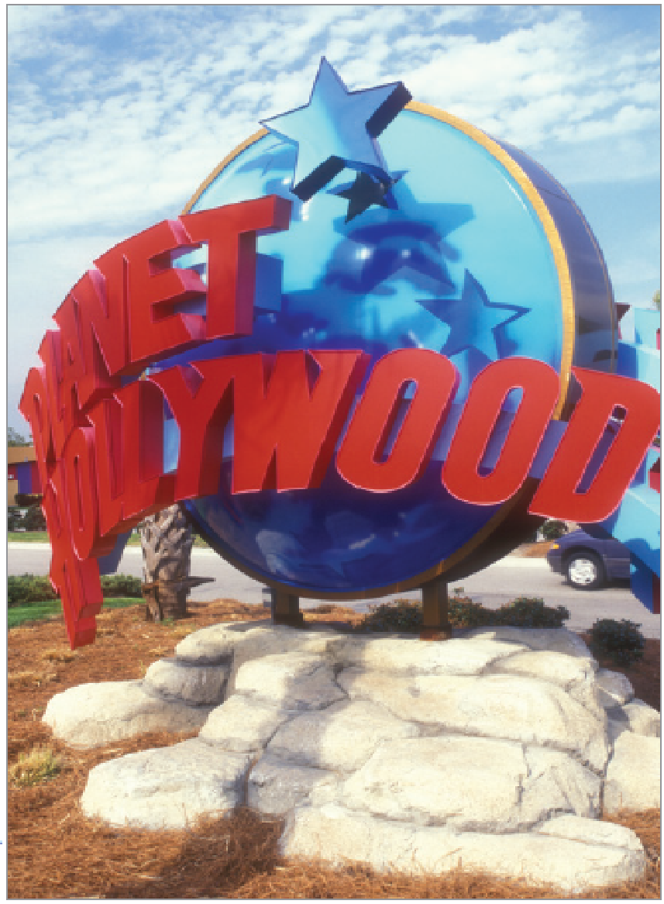
Retailtainment to Satisfy Experiential Shoppers
Retailtainment is all about marketing strategies that enhance the shopping experience.
Many consumers are seeking fun!
Retail experiences that incorporate elements of surprise, excitement, and novelty lead to increased purchase likelihood.

Slide 12
Ethical Problems in Retailing
Retailers must deal with ethical problems that involve both customers and employees.
Shoplifting
Employee theft
Retail “borrowing”
Ethical treatment of customers
Customer profiling
Sale of harmful products
Notes:
Retail borrowing occurs when nondefective products are returned and a refund is received for items that have already been used for the purpose for which they were bought. Liberal return policies of many merchandisers have allowed consumers to take advantage of “the system” in this fashion. Retail borrowing often occurs with special occasion clothing (suits, cocktail dresses for weddings, etc.). Unfortunately, sometimes this practice damages the merchandise in a manner that it makes unsuitable for resale, costing the retailer and manufacturer money.
Some individuals believe that retailers have an obligation not to sell products that can be harmful to at risk groups. Retailers are obligated to follow the law, meaning that they must card those who purchase alcohol and tobacco products and follow appropriate regulations for the purchase of firearms and drug products. But there are limits to what retailers can be realistically asked to do. Expecting retailers to police the purchase of every item that could be potentially dangerous or harmful (particularly if misused) is irrational.

Slide 13
Ethical/Sustainable Decisions in the Real World
Most clothing purchased in the United States is made in developing countries.
Workers earn less than a living wage.
Fair Trade movement is gaining momentum.
Should all retailers seek out and buy Fair Trade goods?

Slide 14
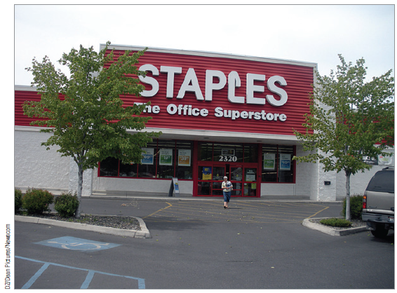
Category Killer
A category killer is a specialty store that carries a large section of products within a given category.
Best Buy
Lowe’s
Toys-R-Us

Slide 15
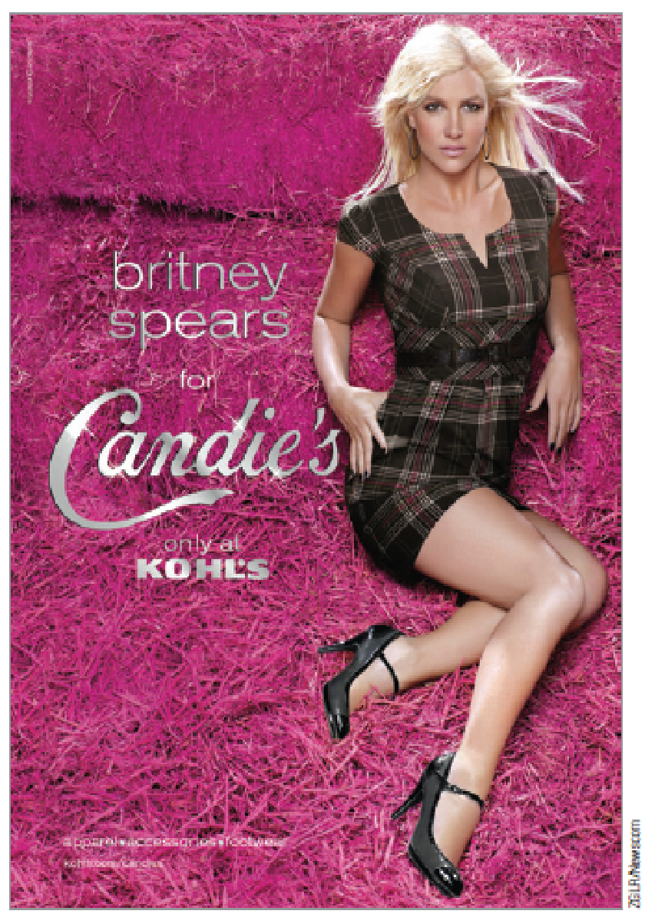
Department Stores
Department stores sell a broad range of items and offer a deep selection organized into different sections.
Full-service U.S. department stores have struggled in recent years.

Slide 16
Popup Stores
Popup stores are temporary retail spaces that a company erects to help build buzz for its products.
Seasonal popup stores at Halloween and Christmas sell costumes and Christmas decorations.

Slide 17
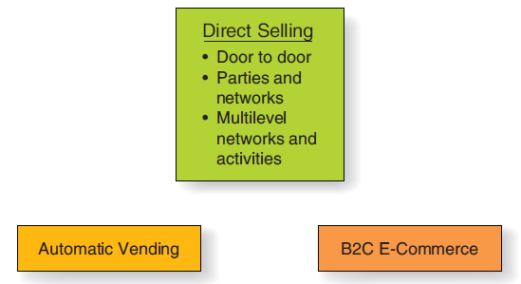
E-Commerce and Other Types of Nonstore Retailing
Nonstore retailing is any method a firm uses to complete an exchange that does not require a customer to visit a store

Slide 18
B2C E-Commerce
B2C e-commerce is online exchange between companies and individual consumers.
Shoppers purchased $373 billion in consumer goods online in 2016.
Experts predict that by 2017:
60% of all U.S. retail sales will involve the web in some way.
Web-influenced sales will increase to $1.8 trillion.
M-commerce is promotional or other e-commerce activities over mobile devices.

Slide 19
Benefits of B2C E-Commerce
Virtual Experiential Marketing is an online marketing strategy that engages experiential shoppers online by using:
Colors
Graphics
Layout and Design
Interactive Videos
Contests
Games
Giveaways

Slide 20
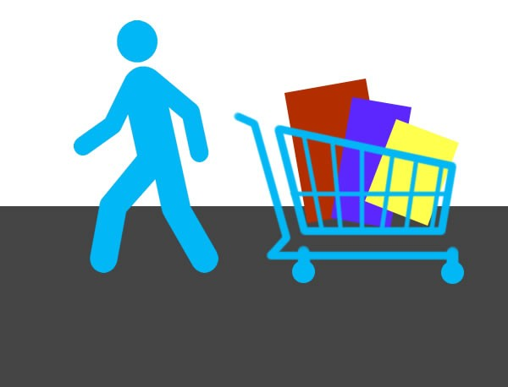
Limitations of B2C E-Commerce
Shopping Cart Abandonment occurs when e-commerce customers leave an e-commerce site with unpurchased items in their cart.

Slide 21
B2C’s Effect on the Future of Retailing
Does growth of B2C e-commerce mean the death of bricks-and-mortar stores as we know them?
Virtual distribution channels unlikely to replace traditional ones
Stores must evolve to lure customers away from the computer.
Consumers will visit destination retail more for the fun they receive from the total experience.

Slide 22
Direct Selling
Direct selling occurs when a salesperson presents a product to one individual or a small group, takes orders, and delivers the merchandise.
Door-to-door sales
Party and networks
Multilevel marketing

Slide 23
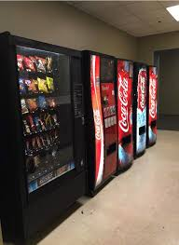
Automatic Vending
Automatic vending
Usually best suited to low-cost convenience goods
Offers many benefits to consumers and marketers

Slide 24
Marketing What isn’t There
Services are acts, efforts, or performances exchanged from producer to user without ownership rights.
Service industry account for four out of every five jobs in the United States and nearly 80% of GDP.
Services are targeted toward both consumers and organizations.
Intangibility of services creates unique opportunities and challenges for marketing.

Slide 25
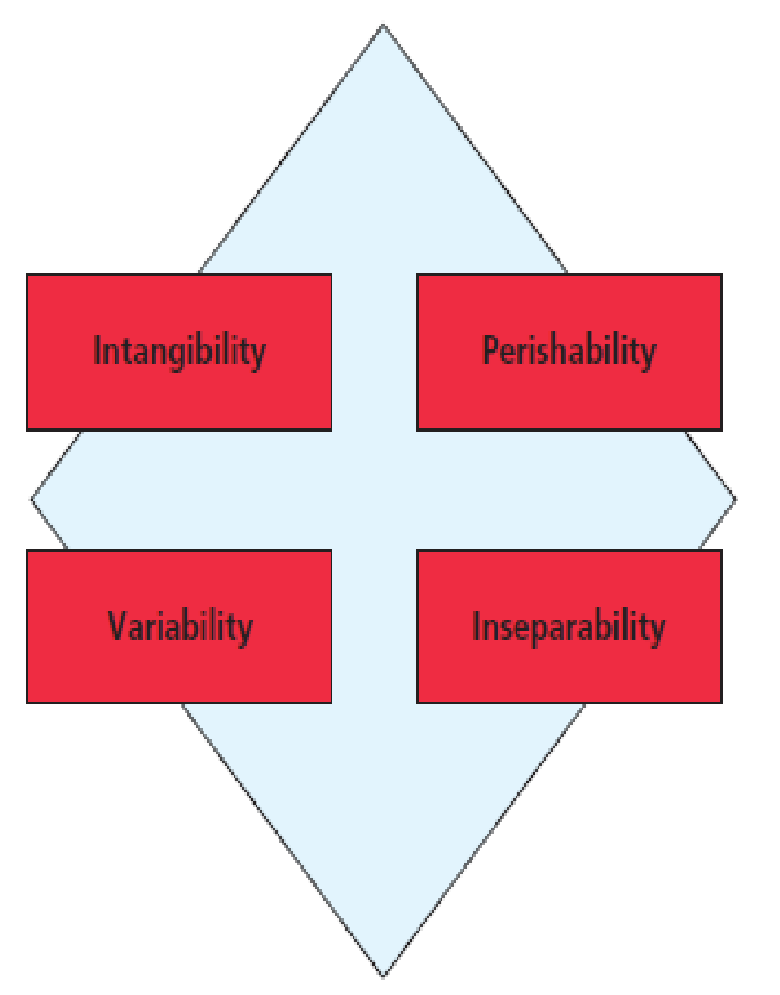
Characteristics of Services
Notes:
Intangibility: Can’t see, touch, or smell a service. This means services can’t be inspected or tried prior to purchase, which makes it much more difficult to evaluate services offered by different providers. Thus marketers rely on physical cues to reassure the buyer that they are buying a good service. Cues might include the “look” of the facility, its furnishings, lighting, cleanliness, employee appearance, web site or advertising.
Perishability: Services can’t be stored for later sale or consumption and instead MUST be used at the time they are available. There are so many appointment periods in a doctor’s day . . . An empty slot at 8 am cannot be saved and used later. Capacity management allows firms to adjust their services to match supply with demand. We’ll discuss capacity management in more detail soon.
Variability: Even the same service performed by the same person will vary when delivered on different days or at different times. Lack of standardization is often perceived as a problem. Training can minimize wide variations in service delivery, but it is often difficult to eliminate entirely. Explicit standards and operating procedures may also help to minimize variability, while mystery shoppers and customer feedback can be used to identify cases of poor service quality. However, in many cases, the variability of services actually allows different customers to customize services to their preferences (unique hairstyles).
Inseparability: Because services must be experienced to be used, it is impossible to separate the production of a service from its consumption. Its difficult to detach the expertise, skill, and personality of a provider from the firm’s employees (especially when services are delivered by people).

Slide 26
Strategic Issues When We Deliver Service Quality
Quality service ensures that customers are satisfied with what they have paid for. Satisfaction is based on customer expectations.
Not all customers expect the same level of service.
Not all customers can be satisfied.
The SERVQUAL scale is a popular instrument to measure customer service quality. It identifies consumer perceptions of service quality on five components:
Tangibles
Reliability
Responsiveness
Empathy
Assurance

Slide 27
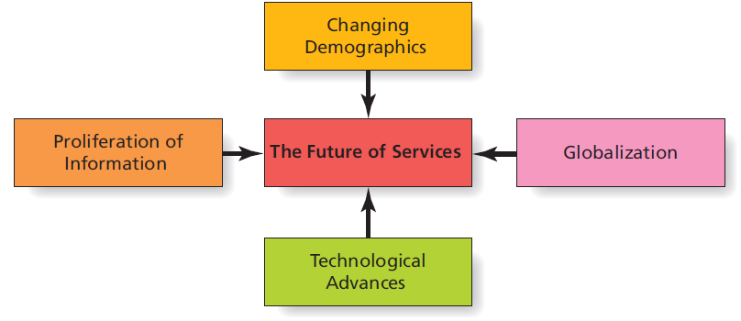
Factors that Shape the Future of Services
Notes:
Changing demographics: The surge in the birth rate following World War II created the baby boom. As this large group continues to age, service industries which appeal to this demographic will be in high demand (retirement communities, health care, assisted living, etc.).
Globalization: This trend will increase the need for distribution, logistical, accounting, and legal services that have specialized international knowledge. Globalization also means greater competition; for example, U.S. Hospitals will need to compete for elective surgeries with medical facilities in other countries that cost much less.
Technological advances: Improvements in technology offer service providers opportunity for growth in the telecommunications, health care, and Internet service industries. Innovation is also likely as some services which will be offered in the future haven’t even been thought of yet.
Proliferation of information: The availability, flow and access to information are critical to the success of organizations. Database services, artificial intelligence systems and communications systems in general stand to benefit in the future.

